Slide 1
Database Management System
Lecture # 23-24

Slide 2
Set Operators
SQL supports few Set operations which can be performed on the table data. These are used to get meaningful results from data stored in the table, under different special conditions.
In this tutorial, we will cover 4 different types of SET operations, along with example:
Union
Union all
Intersect
Minus

Slide 3
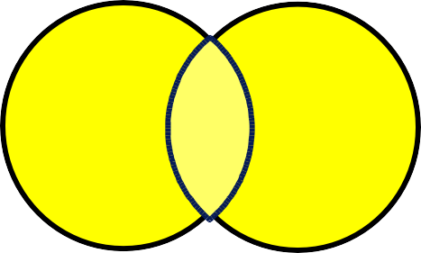
Set Operators
A
B
A B
UNION/UNION ALL
A
B
INTERSECT
A
B
MINUS

Slide 4
Sample data
In order to explain the SET operators, the following two lists will be referred to throughout this lesson:
A = {1, 2, 3, 4, 5}
B = {4, 5, 6, 7, 8}
Or in reality: two tables, one called A and one called B.
A B
A_ID
1
2
3
4
5
B_ID
4
5
6
7
8

Slide 5
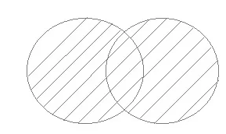
UNION Operation
UNION is used to combine the results of two or more SELECT statements. However it will eliminate duplicate rows from its resultset. In case of union, number of columns and data type must be same in both the tables, on which UNION operation is being applied.

Slide 6
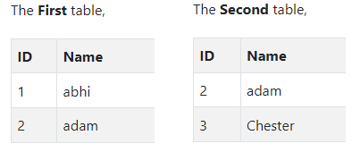
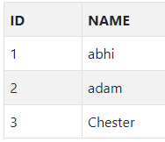
Example of UNION
Resultset table

Slide 7
SQL Query of Union
SELECT * FROM First
UNION
SELECT * FROM Second;

Slide 8

Another Example
We Know that the UNION operator returns all rows from both tables, after eliminating duplicates.
SELECT a_id FROM a UNION
SELECT b_id FROM b;
A
B
1
2
3
4
5
6
7
8
The result of listing all elements in A and B eliminating duplicates is {1, 2, 3, 4, 5, 6, 7, 8}.
If you joined A and B you would get only {4, 5}. You would have to perform a full outer join to get the same list as above.

Slide 9
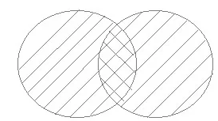
UNION ALL
This operation is similar to Union. But it also shows the duplicate rows.

Slide 10
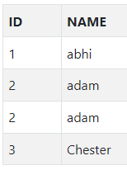
Example of Union All
Resultset table

Slide 11
SQL Query of UNION ALL
SELECT * FROM First
UNION ALL
SELECT * FROM Second;

Slide 12

Another Example
We Know that the UNION ALL operator returns all rows from both tables, without eliminating duplicates.
SELECT a_id FROM a
UNION ALL
SELECT b_id FROM b;
A
B
1
2
3
4
5
4
5
6
7
8
The result of listing all elements in A and B without eliminating duplicates is {1, 2, 3, 4, 5, 4, 5, 6, 7, 8}.

Slide 13
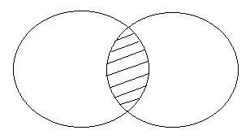
INTERSCTION
Intersect operation is used to combine two SELECT statements, but it only returns the records which are common from both SELECT statements. In case of Intersect the number of columns and data type must be same.
NOTE: MySQL does not support INTERSECT operator.

Slide 14

Example of INTERSCTION
Resultset table

Slide 15
SQL Query of INTERSCTION
SELECT * FROM First
INTERSECT
SELECT * FROM Second;

Slide 16
Another Example
We know that the INTERSECT operator returns all rows common to both tables.
SELECT a_id FROM a INTERSECT
SELECT b_id FROM b;
A
B
4
5
The result of listing all elements found in both A and B is {4, 5}.

Slide 17
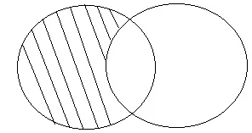
MINUS
The Minus operation combines results of two SELECT statements and return only those in the final result, which belongs to the first set of the result.

Slide 18

Example of MINUS
Resultset table

Slide 19
SQL Query of MINUS
SELECT * FROM First
MINUS
SELECT * FROM Second;

Slide 20

Another Example
The MINUS operator returns all rows found in one table but not the other.
SELECT a_id FROM a MINUS
SELECT b_id FROM b;
A
B
1
2
3
The result of listing all elements found in A but not B is {1, 2, 3}.
The result of B MINUS A would give {6, 7, 8}.

Slide 21
Set Operator Examples
Sometimes if you are selecting rows from tables that do not have columns in common, you may have to create your own columns in order to match the number of columns in the queries.
The easiest way to do this is to include one or more NULL values in the select list.
Remember to give each one a suitable alias and matching data type.

Slide 22
Set Operator Examples
For example:
The employees table contains a hire date, employee id and a job id.
The job history table contains employee id and job id, but does not have a hire date column.
The two tables have the employee id and job id in common, but job history does not have a start date .

Slide 23
What is an SQL Sequence?
Sequence is a feature supported by some database systems to produce unique values on demand. Some DBMS like MySQL supports AUTO_INCREMENT in place of Sequence.
AUTO_INCREMENT is applied on columns, it automatically increments the column value by 1 each time a new record is inserted into the table.
Sequence is also some what similar to AUTO_INCREMENT but it has some additional features too.

Slide 24
Creating a Sequence
Common terms are:
The initial-value specifies the starting value for the Sequence.
The increment-value is the value by which sequence will be incremented.
The maximum-value specifies the upper limit or the maximum value up-to which sequence will increment itself.
The keyword CYCLE specifies that if the maximum value exceeds the set limit, sequence will restart its cycle from the beginning.
And, NO CYCLE specifies that if sequence exceeds MAXVALUE value, an error will be thrown.

Slide 25
Creating a Sequence
CREATE SEQUENCE sequence-name
START WITH initial-value
INCREMENT BY increment-value
MAXVALUE maximum-value
CYCLE | NOCYCLE;

Slide 26
Example: Sequence in SQL Query
Let's start by creating a sequence, which will start from 1, increment by 1 with a maximum value of 999.
CREATE SEQUENCE seq_1
START WITH 1
INCREMENT BY 1
MAXVALUE 999
CYCLE;

Slide 27
SQL VIEW
A VIEW in SQL is a logical subset of data from one or more tables. View is used to restrict data access.
As you may have understood by seeing the below SQL query, a view is created using data fetched from some other table(s). It's more like a temporary table created with data.
Syntax for creating a View,
CREATE or REPLACE VIEW view_name
AS
SELECT column_name(s)
FROM table_name
WHERE condition

Slide 28
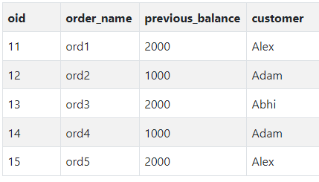
Creating a VIEW
Consider following Sale table,
SQL Query to Create a View from the above table will be,

Slide 29
Creating a VIEW
CREATE or REPLACE VIEW sale_view
AS
SELECT * FROM Sale WHERE customer = 'Alex';
The data fetched from SELECT statement will be stored in another object called sale_view. We can use CREATE and REPLACE separately too, but using both together works better, as if any view with the specified name exists, this query will replace it with fresh data.

Slide 30
Displaying a VIEW
The syntax for displaying the data in a view is similar to fetching data from a table using a SELECT statement.
SELECT * FROM sale_view;

Slide 31
Force VIEW Creation
FORCE keyword is used while creating a view, forcefully. This keyword is used to create a View even if the table does not exist. After creating a force View if we create the base table and enter values in it, the view will be automatically updated.
Syntax for forced View is,
CREATE or REPLACE FORCE VIEW view_name AS
SELECT column_name(s)
FROM table_name
WHERE condition;

Slide 32
Update a VIEW
UPDATE command for view is same as for tables.
Syntax to Update a View is,
UPDATE view-name SET VALUE
WHERE condition;
NOTE: If we update a view it also updates base table data automatically.

Slide 33
Read-Only VIEW
We can create a view with read-only option to restrict access to the view.
Syntax to create a view with Read-Only Access
CREATE or REPLACE FORCE VIEW view_name AS
SELECT column_name(s)
FROM table_name
WHERE condition WITH read-only;
The above syntax will create view for read-only purpose, we cannot Update or Insert data into read-only view. It will throw an error.

Slide 34
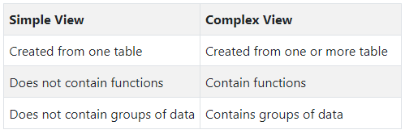
Types of View

Slide 35
Thanks

